Slide 1




NEXT GEN EMPLOYABILITY PROGRAM
Creating a future-ready workforce
Team Members
College Name
Student Name :SHIVANI S M
Student ID :au960221243043
Arunachala college of Engineering for women

Slide 2

CAPSTONE PROJECT SHOWCASE
Project Title
Car Rental Application using Django Framework
Abstract | Problem Statement | Project Overview | Proposed Solution | Technology Used | Modelling & Results | Conclusion

Slide 3
Abstract
Our project aims to develop a comprehensive car rental platform leveraging Django framework. The application facilitates users to browse, search, and book rental cars seamlessly.
It encompasses multiple Django apps for user management, car listings, rental bookings, and administrative tasks. Through intuitive user interfaces and robust backend functionalities, users can effortlessly manage their rental preferences and bookings.
The application employs Django's ORM for database interactions and ensures data security through authentication and authorization mechanisms. Additionally, it integrates Django's admin interface for efficient management of application data. Deployment on various web servers like Heroku or AWS enables accessibility to a wide range of users, promising a reliable and scalable solution for car rental services.
Source :

Slide 4
Problem Statement
The traditional car rental process is fraught with inefficiencies and complexities, posing challenges for both customers and rental companies. For customers, renting a car often entails cumbersome paperwork, limited vehicle availability, and unclear booking procedures, leading to frustration and inconvenience. Moreover, the lack of transparency in pricing and rental terms can further exacerbate these issues, resulting in a poor customer experience.
On the other hand, rental companies grapple with managing their fleet effectively, coordinating bookings, and ensuring customer satisfaction amidst manual administrative tasks and logistical challenges. These inefficiencies not only hinder operational efficiency but also impact the company's reputation and profitability.. Thus, developing a car rental application using Django presents an opportunity to address these challenges and revolutionize the way car rentals are conducted, benefiting both customers and rental companies.
Source :

Slide 5
Project Overview
The car rental application will feature a user authentication system to ensure secure access for both customers and administrators. Customers will be able to browse through a comprehensive list of available rental cars, including detailed descriptions and images for each vehicle. They can easily book a car for their desired dates, with real-time availability tracking ensuring accurate booking information.
Integrated payment processing will enable users to securely complete transactions online, offering convenience and reliability. The application will also include an intuitive admin dashboard, empowering rental companies to manage their fleet efficiently, monitor bookings, and track rental activity.
Furthermore, the application will prioritize a responsive design, ensuring seamless usability across various devices such as desktops, tablets, and smartphones. By leveraging Django's robust framework, the project aims to deliver a scalable, reliable, and user-centric solution that revolutionizes the car rental experience.
Source :

Slide 6
Proposed Solution
User Authentication:
Implement user authentication functionalities such as registration, login, and password reset using Django's built-in authentication system.
Ensure secure access to user accounts and sensitive information.
Car Listings:
Develop a feature to display available rental cars with detailed information such as make, model, year, mileage, and rental rates.
Enable users to filter and search for cars based on criteria such as location, vehicle type, and rental duration.
Rental Bookings:
Create a booking system allowing users to select rental dates, choose desired vehicles, and make reservations.
Implement validation to prevent double bookings and ensure availability.
Real-time Availability Tracking:
Integrate real-time availability tracking to update car availability status based on bookings made by users.
Provide instant feedback to users regarding the availability of their chosen rental dates.
Source :

Slide 7
5.Admin Dashboard:
Develop an intuitive admin dashboard for rental companies to manage their fleet, add or remove vehicles, and track bookings.
Provide functionalities for administrators to view rental history, manage user accounts, and generate reports.
6.Responsive Design:
Ensure the application is responsive and compatible with various devices including desktops, tablets, and smartphones.
Utilize CSS frameworks like Bootstrap to create a visually appealing and user-friendly interface..
7.Testing and Quality Assurance:
Conduct thorough testing of the application to identify and address any bugs or issues.
Perform usability testing to ensure the application meets the needs of both users and administrators.
8.Documentation and Deployment:
Document the application's features, functionalities, and deployment process for reference.
Deploy the application to a reliable web hosting platform such as Heroku or AWS, ensuring scalability and availability.
Source :

Slide 8


Technology Used
Front-end
Back-end
Source :

Slide 9
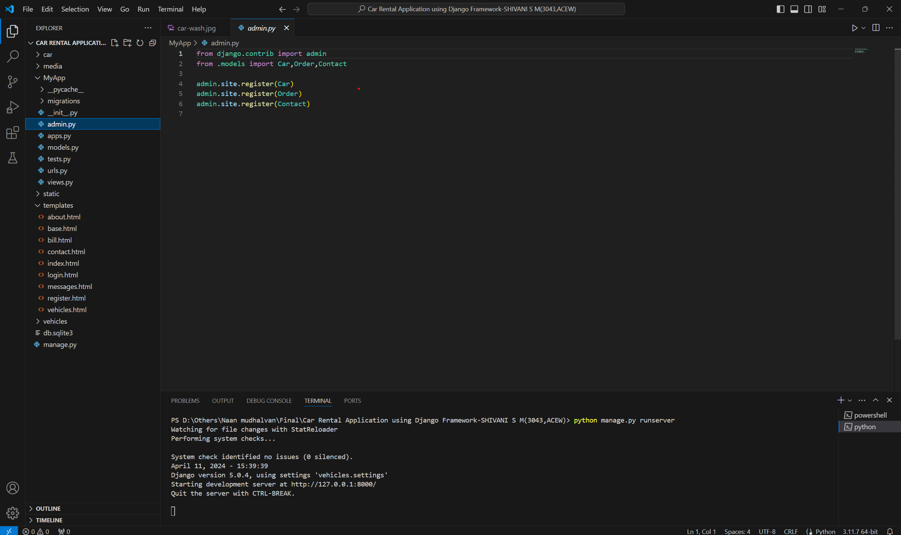
Modelling & Results
Source :

Slide 10
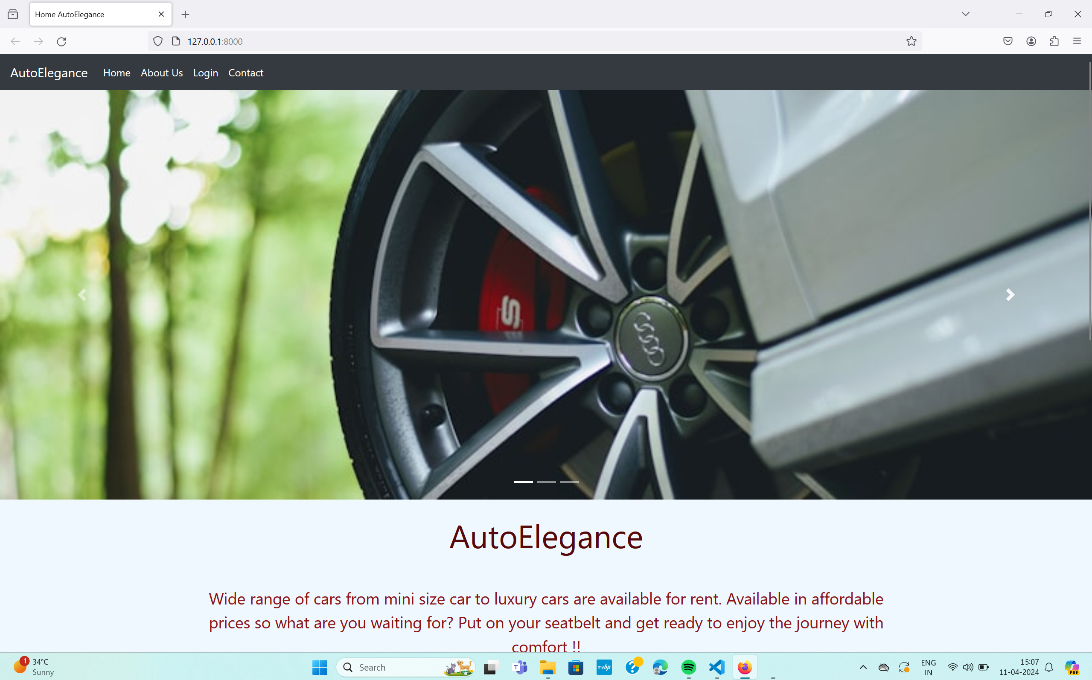
Homepage

Slide 11
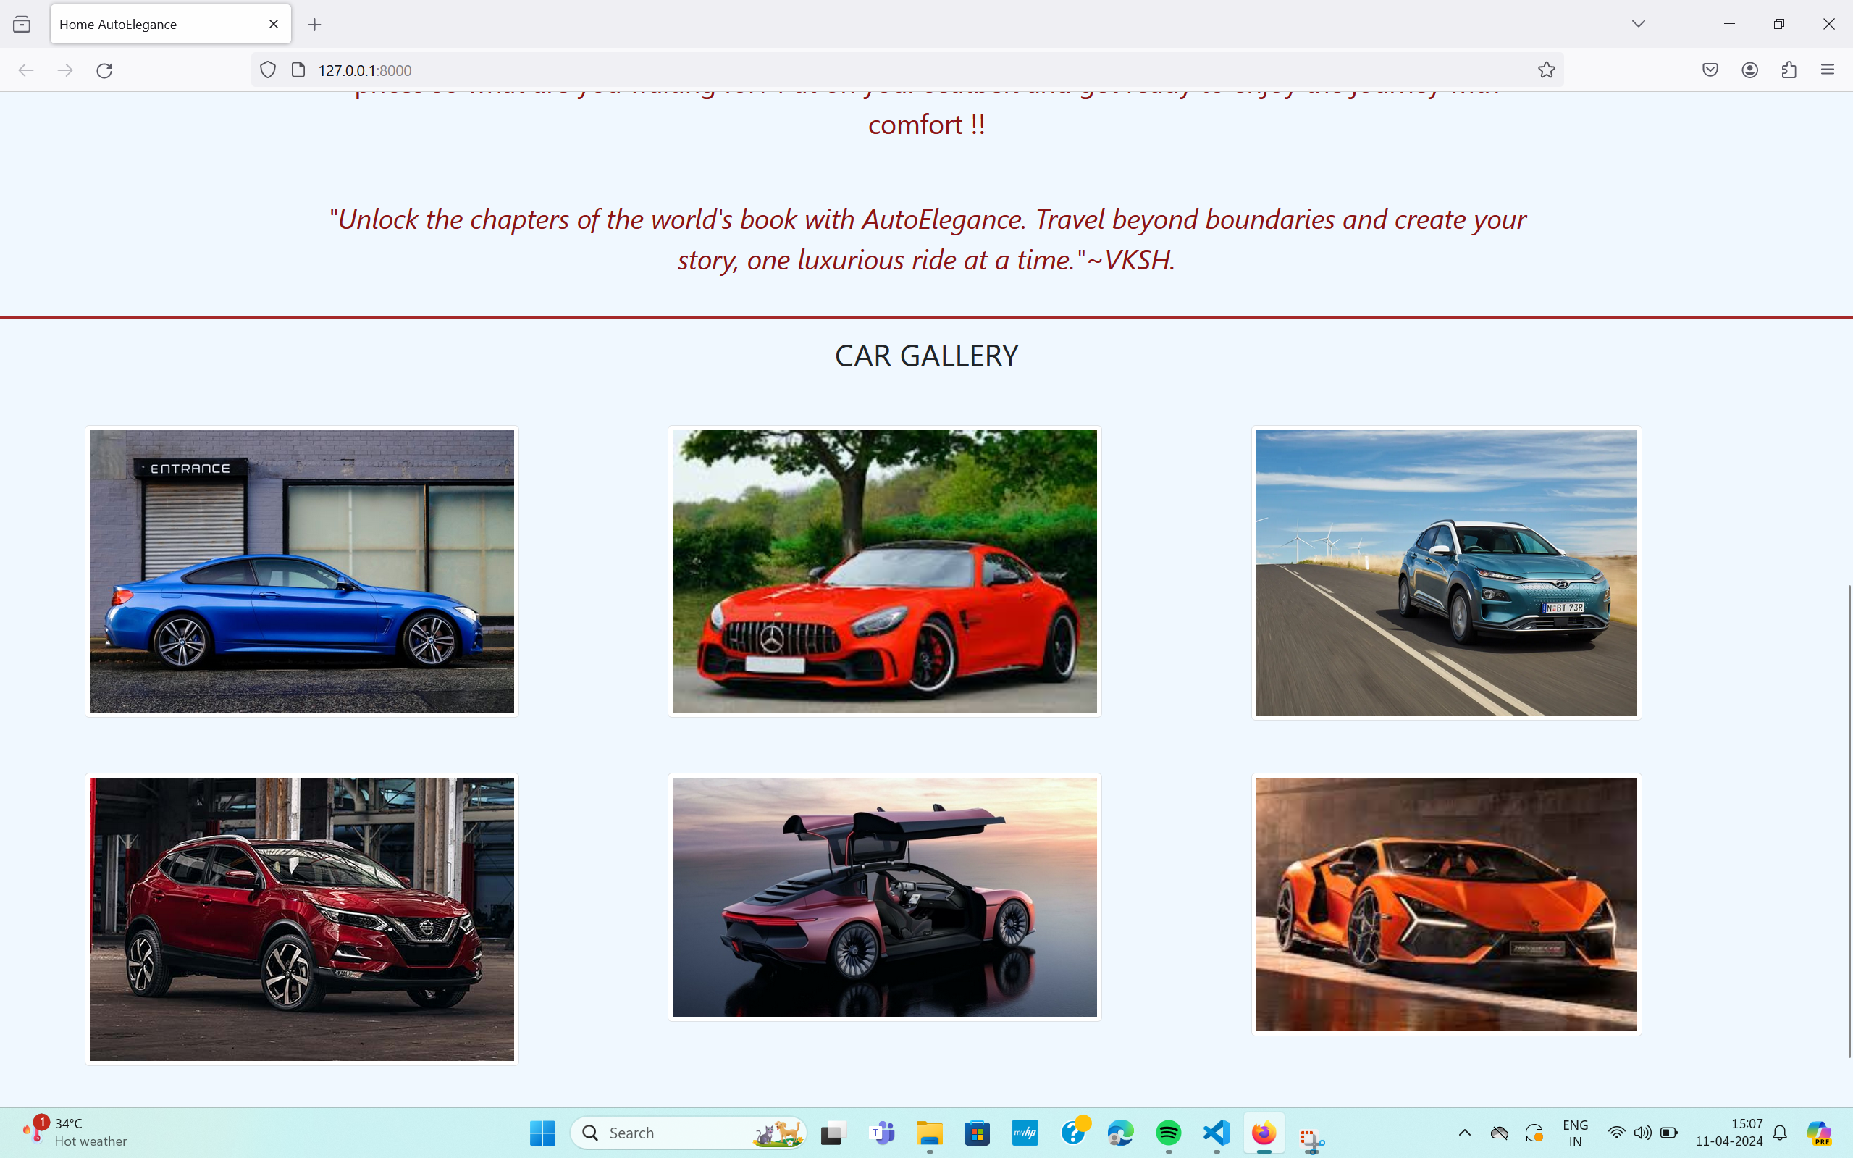
Homepage

Slide 12
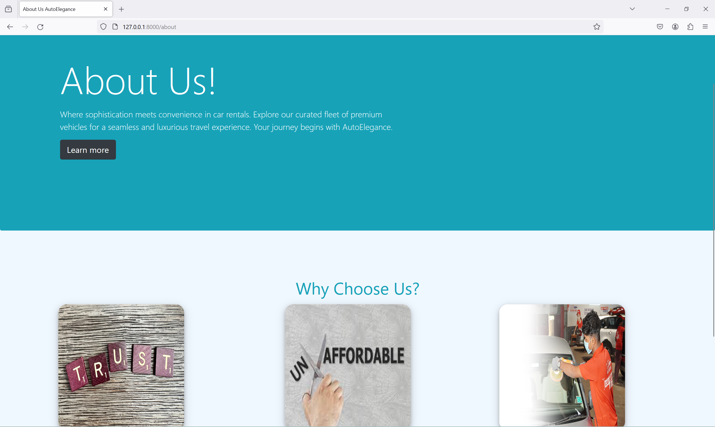
About-Us-Page

Slide 13
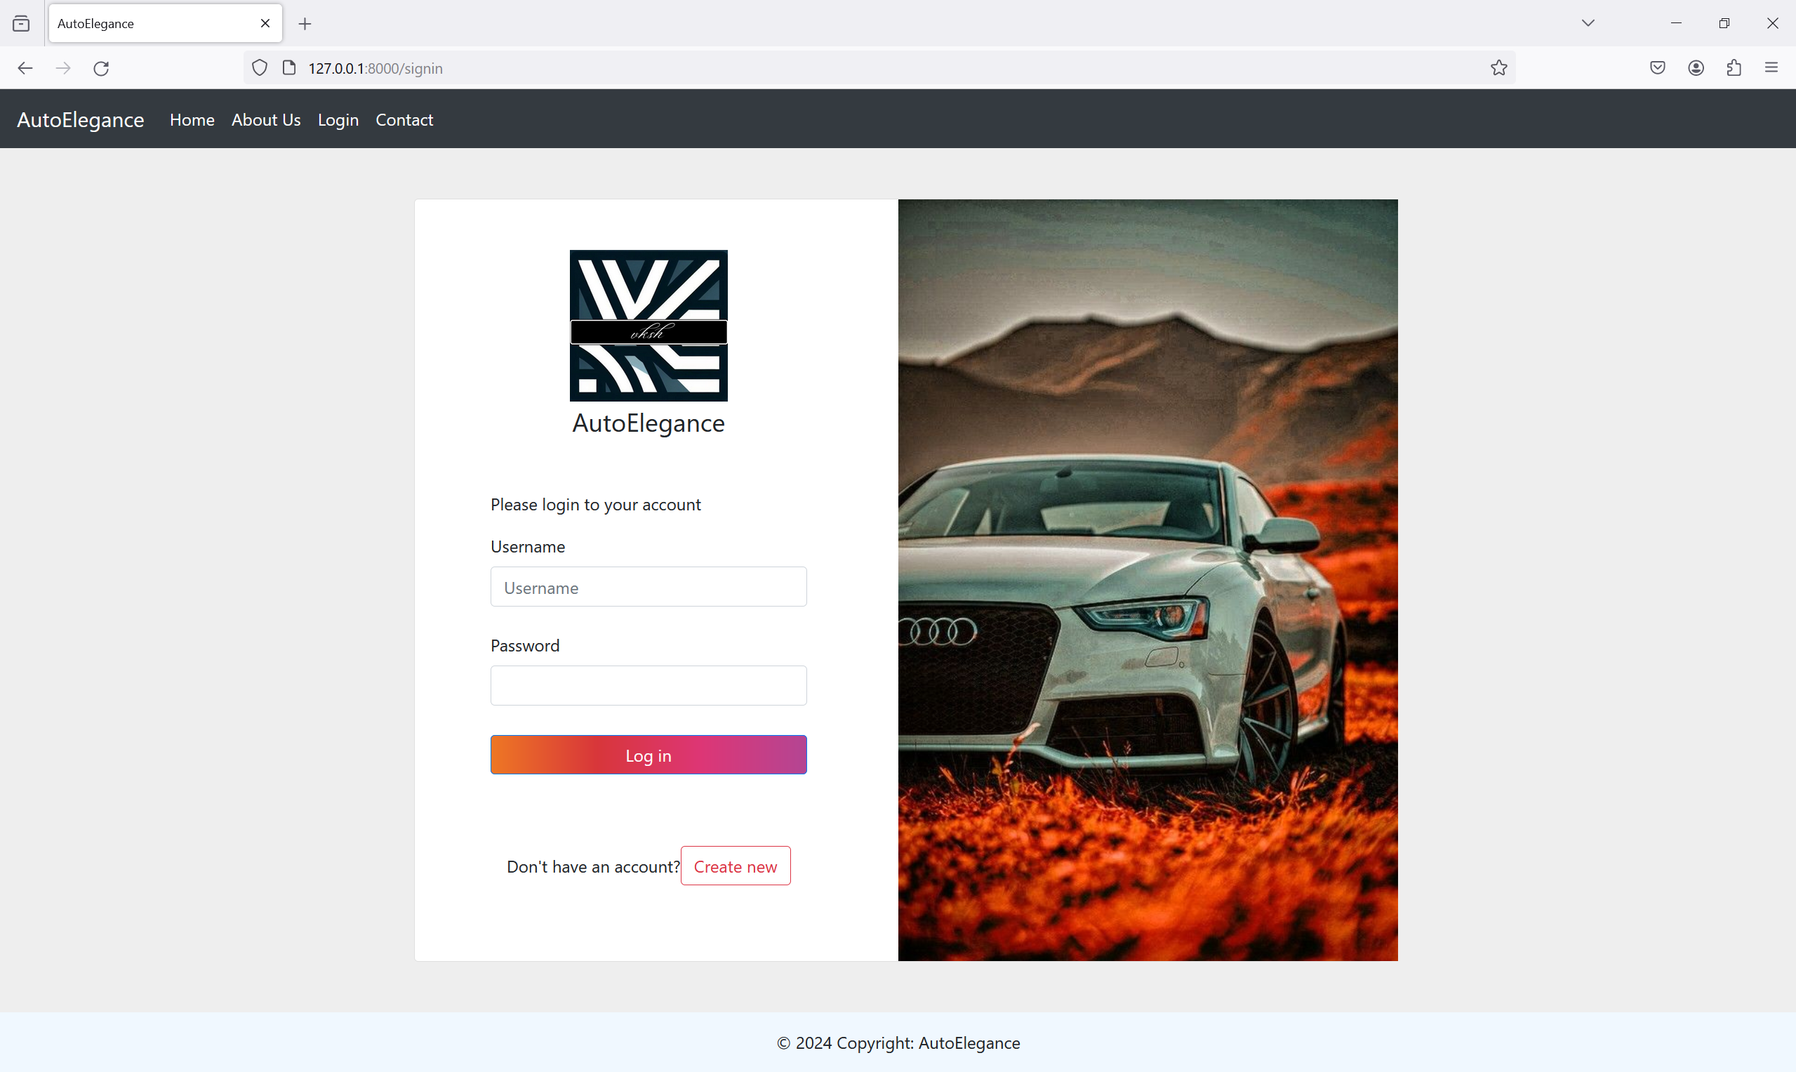
Login-Page

Slide 14
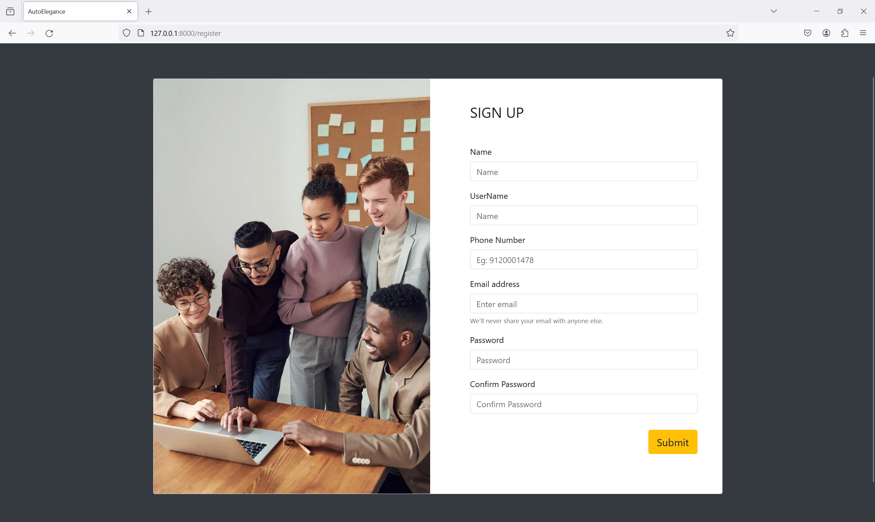
Register-Page

Slide 15
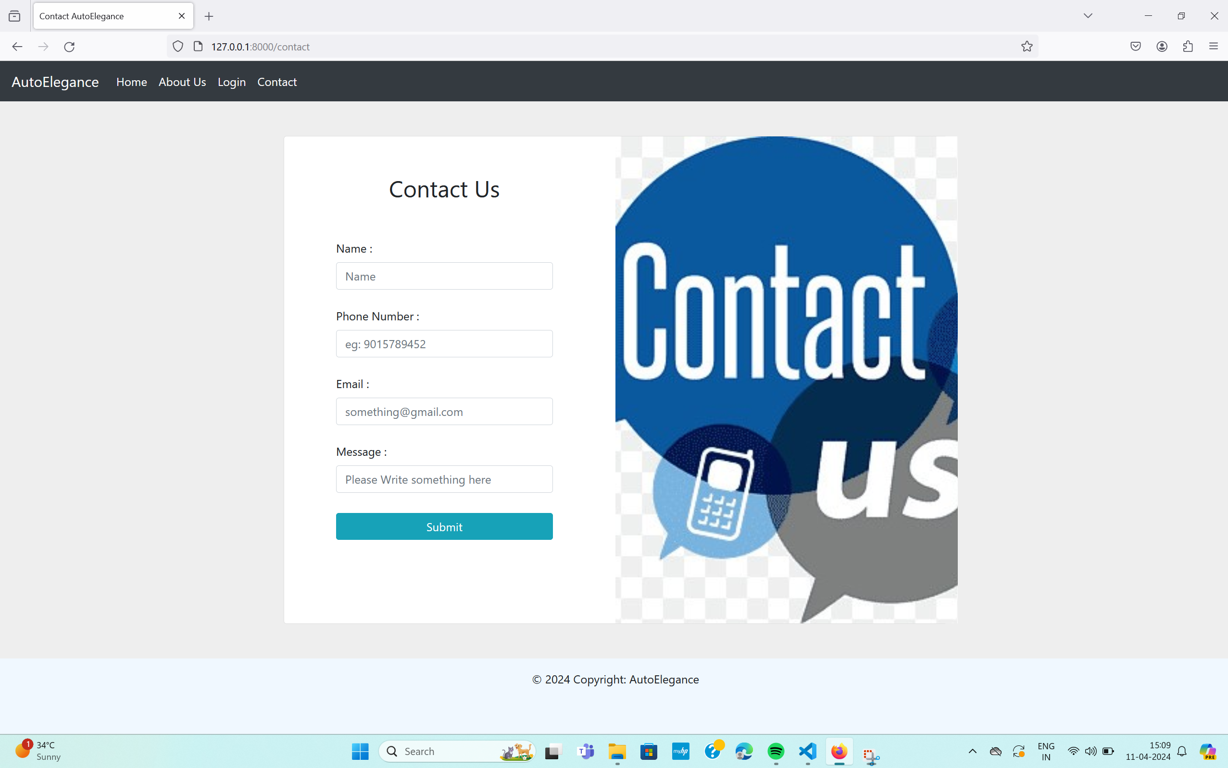
Contact us

Slide 16
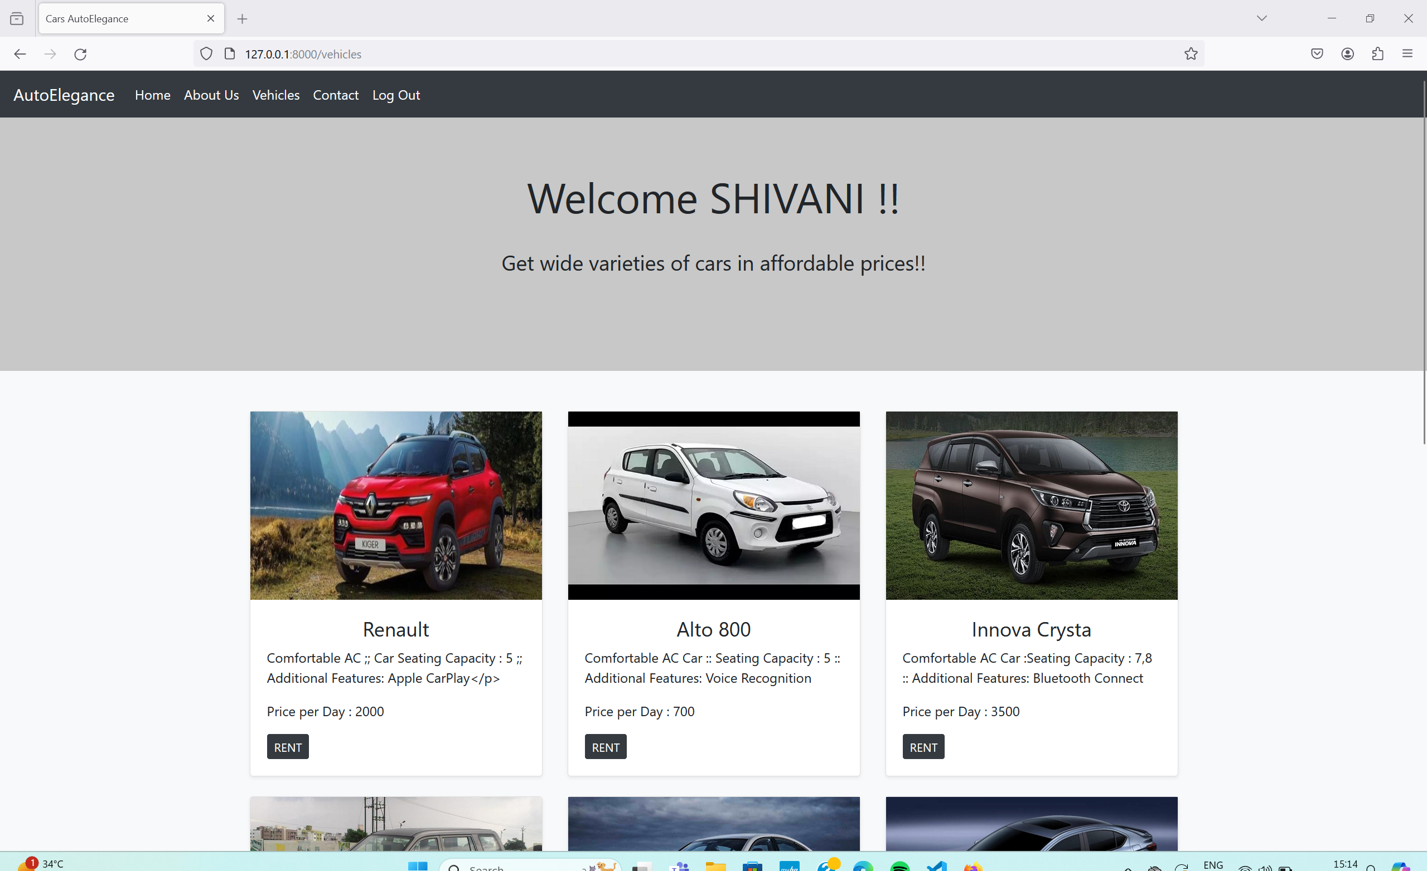
Vehicles

Slide 17
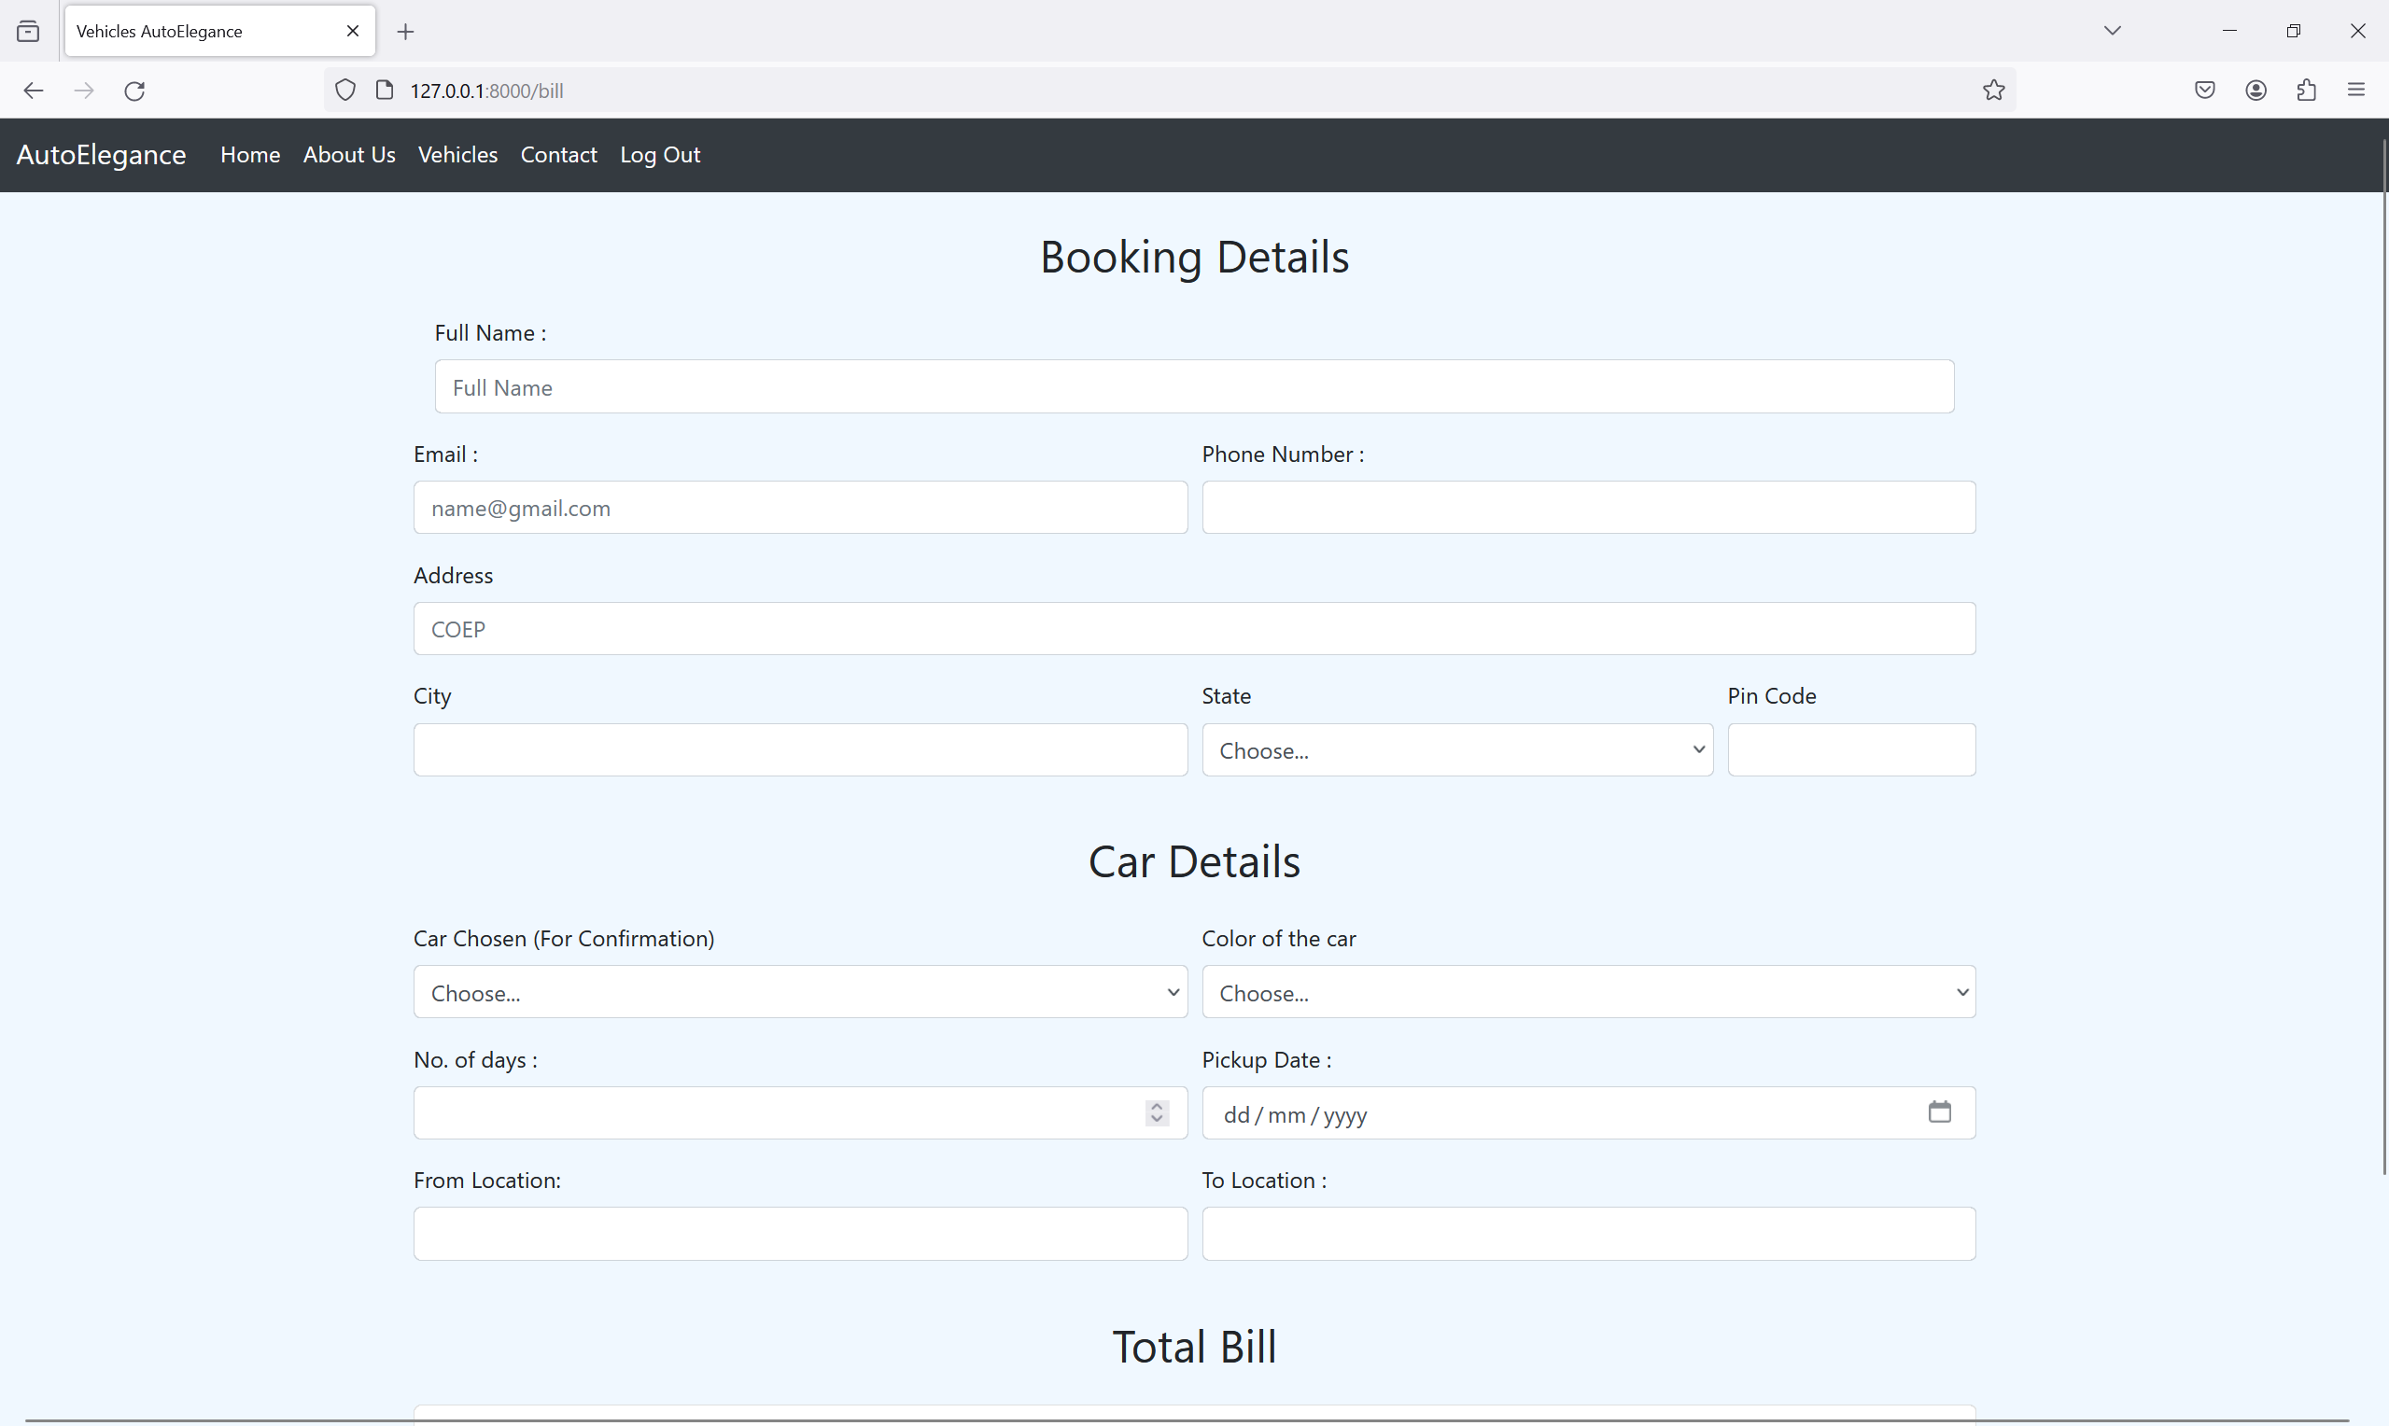
Booking

Slide 18
Future Enhancements:
Online Payment Integration: Implement online payment processing capabilities to allow users to make secure payments directly through the application using credit/debit cards or digital wallets.
Rating and Reviews: Introduce a rating and review system where users can provide feedback and ratings for rental cars and overall rental experience, helping future users make informed decisions.
Advanced Search and Filtering: Enhance the search and filtering functionality to allow users to search for rental cars based on specific criteria such as fuel type, transmission, seating capacity, or additional features like GPS or child seats.
Notifications: Implement a notification system to send email or SMS notifications to users regarding booking confirmations, reminders for upcoming rentals, or notifications about special offers and promotions.
Subscription Plans: Introduce subscription-based plans for frequent users or corporate clients, offering discounted rates, priority booking, and other perks.
Multi-language Support: Incorporate multi-language support to cater to users from different regions, allowing them to access the application in their preferred language.

Slide 19
Conclusion
In summary, the car rental application built with Django provides a robust solution for simplifying the rental process. Its current features include user authentication, comprehensive car listings, and booking capabilities without online payment. However, it holds potential for future enhancements such as integrating online payments and refining search functionalities. With a focus on usability, security, and scalability, the application aims to modernize and improve the rental experience for both customers and rental companies.
Source :

Slide 20
Thank You!
Notes:
Thank You !!

